Slide 1
OMSE 510
Distributed SE Team Collaboration
Week 4
Intercultural Sensitivity and Conflict

Slide 2
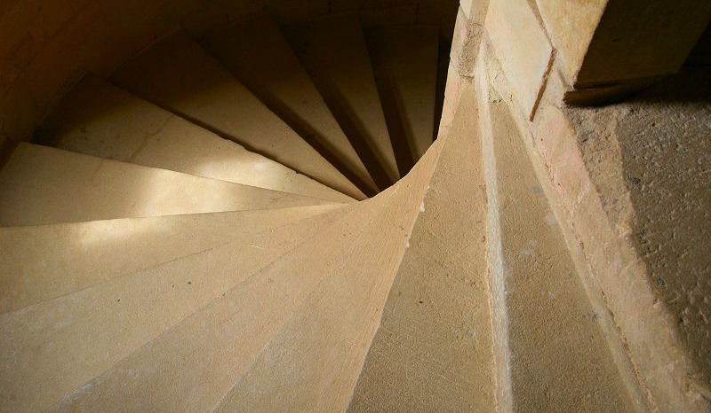
The Developmental Model of Intercultural Sensitivity (DMIS)
Bennett (2003)

Slide 3
Developmental Model of Intercultural Sensitivity*
#1 | #2 | #3 | #4 | #5 | #6
Denial
Defense
Minimization
Acceptance
Adaptation
-Cognitive
-Behavioral
Integration
Ethnocentric Stages
Ethnorelative Stages

Slide 4
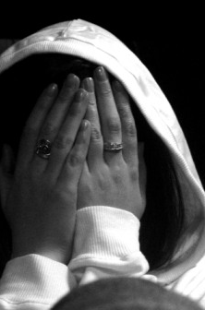
Denial
Assumes there are no real differences among people from different cultures
People say:
“As long as we speak the same language there’s no problem”
“I never experience culture shock”
“All big cities are the same---lots of buildings, too many cars, Starbucks”

Slide 5
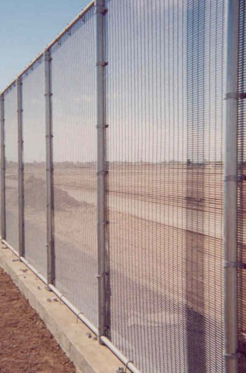
Defense
Differences are recognized, but they are viewed as threatening
People say:
“I wish these people would just talk the way we do”
“Boy, could we teach these people a lot”
“What a sexist society”

Slide 6
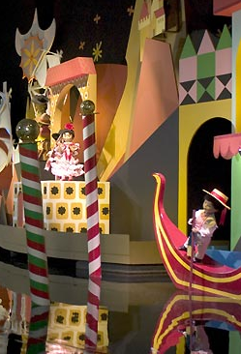
Minimization
Cultural differences are trivialized and similarities are overgeneralized
People say:
“The key to getting along in any culture is just to be yourself--authentic and honest”
“No matter what their culture, people are pretty much motivated by the same things”
“It’s a small world after all”

Slide 7
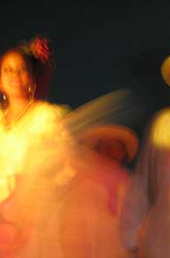
Acceptance
Involves a fundamental acknowledgment that differences exist, they are important, and they should be respected
People say:
“More difference means more creative ideas!”
“I always try to study about a new culture before I go there”
“Where can I learn more about Mexican culture to be effective in my communication?”

Slide 8
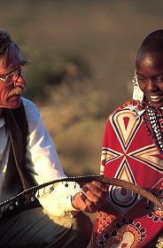
Adaptation
A more proactive effort is made to use cultural differences and intercultural skills to maximize understanding and relationships with people from other cultures
People say:
“To solve this dispute I’m going to have to change my approach”
“I can maintain my values and behave in culturally appropriate ways”
“The more I understand this culture the better I get at the language”

Slide 9

Integration
Involves integrating different aspects of one’s identity into a new whole while remaining culturally marginal
People say:
“Everywhere is home if you know enough about how things work there”
“Whatever the situation, I can usually look at it from a variety of cultural points of view”

Slide 10
Developmental Model of Intercultural Sensitivity
Denial
Defense
Minimization
Acceptance
Adaptation
-Cognitive
-Behavioral
Integration
Individuals interpret events and behavior from their own cultural viewpoint and experience their own culture as central to all reality | Assumes that cultures can only be understood in relation to each other and particular behavior can only be understood within a cultural context
Ethnocentric Stages
Ethnorelative Stages

Slide 11
Where are you now on the DMIS model
(self-assessment)

Slide 12
Cultural Differences
Where do you think you are on the spectrum of intercultural sensitivity?
Where would you say the majority of the people with whom you work would be classified?
In what ways does understanding this help you to work with people who are different than yourself?

Slide 13
References
Bennett, M.J. (1993). Towards ethnorelativism: A developmental model of intercultural sensitivity. In M. Paige (Ed.), Education for the intercultural experience. Yarmouth, ME: Intercultural Press.

